Slide 1
ANNOUNCEMENT
1)Please enroll to the whatsapp group:
2)Lecture notes and the text-book are available at DYS and eng1
3) Find project partners
4) Find some data with at least 30 columns and 500 rows
->multiplication of which should be greater than 15000
5) No artificial-data is allowed (check out Kaggle)
6) LEARN your data before presenting

Slide 2
CENG 3005
Database Management Systems
Week 2
SQL History
What’s a Data Model?
Structure of Relational Databases

Slide 3
SQL: Structured Query Language
SQL: widely used non-procedural language
  Example: Find the name of the customer with customer-id 192-83-7465
  select customer.customer_name
  from customer
  where customer.customer_id = ‘192-83-7465’
  Example: Find the balances of all accounts held by the customer with customer-id 192-83-7465
  select account.balance
  from depositor, account
  where depositor.customer_id = ‘192-83-7465’ and
  depositor.account_number = account.account_number
Application programs generally access databases through one of
  Language extensions to allow embedded SQL
  Application program interface (e.g., ODBC/JDBC) which allow SQL queries to be sent to a database

Slide 4
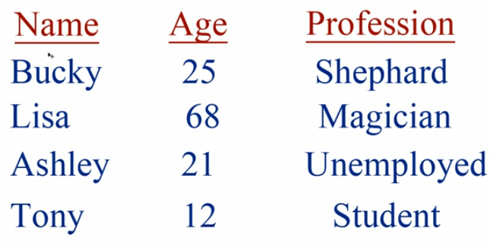


Slide 5
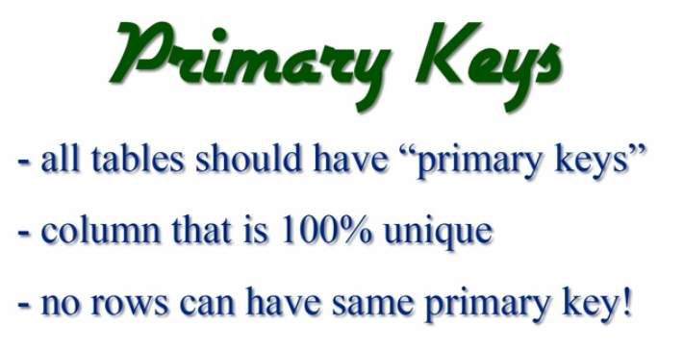

Slide 6
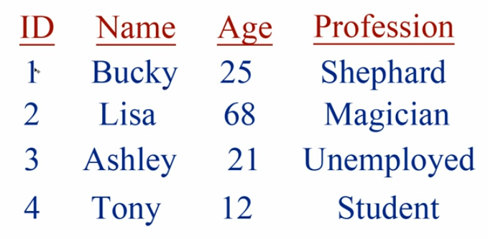

Slide 7

Why Study Databases??
?
Shift from computation to information
  at the “low end”: scramble to webspace (a mess!)
  at the “high end”: scientific applications
Datasets increasing in diversity and volume.
  Digital libraries, interactive video, Human Genome project
  The need for DBMS is exploding!
DBMS encompasses most of CS
  OS, languages, theory, “AI”, multimedia, logic

Slide 8
Structure of a DBMS
These layers
must consider
concurrency
control and
recovery
A typical DBMS has a layered architecture.
This is one of several possible architectures; each system has its own variations.
Query Optimization
and Execution
Relational Operators
Files and Access Methods
Buffer Management
Disk Space Management
DB
Notes:
22

Slide 9

Why Use a DBMS?
Data independence and efficient access.
Reduced application development time.
Data integrity and security.
Uniform data administration.
Concurrent access, recovery from crashes.
What if all our data can fit into RAM (memory)?
  Do we still need databases?
Notes:
3

Slide 10
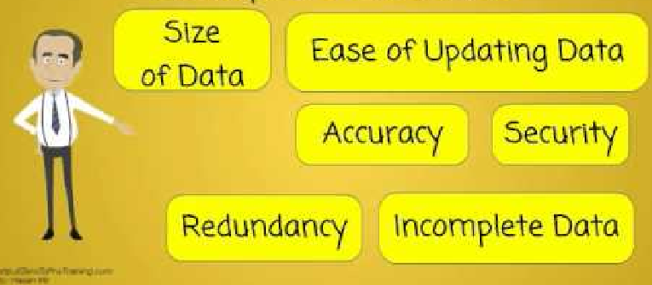
So, why again?

Slide 11
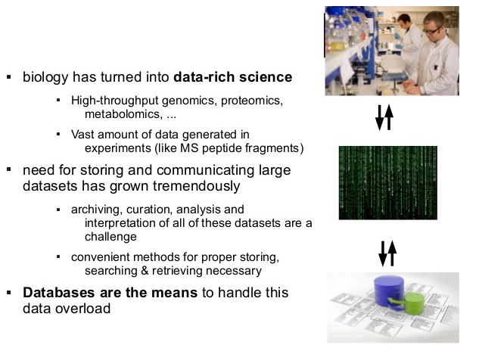
Why do we need databases for Biology?

Slide 12
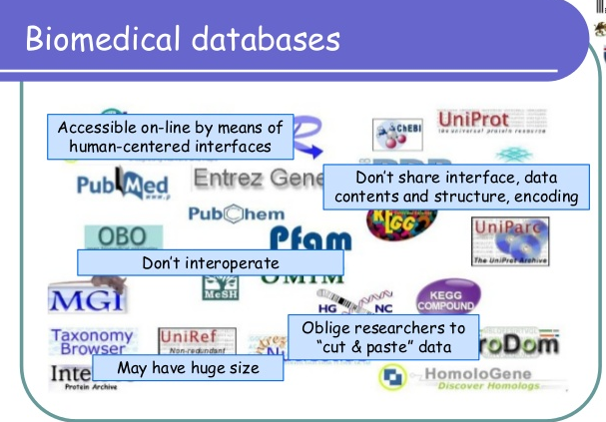

Slide 13
6 steps to mastering SQL for Data Science
Learn Relational Database Basics
    Theoretical foundation is Relational Algebra
    Practical foundation is the File Structures
Learn SQL basics
Learn Selecting/Inserting/Updating
Learn Creating/Dropping/Deleting
    Create and Drop tables
    Delete records
Using Views and Joins
Final goal: SQL integration with R or Python or Java
    SQL is usually embedded in other software written in other programming languages as part of a larger system.
    Some other language making calls to a database via SQL to input, modify, or retrieve application-related data.

Slide 14
SQL History
IBM Sequel language developed as part of System R project at the IBM San Jose Research Laboratory
Renamed Structured Query Language (SQL)
ANSI and ISO standard SQL:
  SQL-86
  SQL-89
  SQL-92
  SQL:1999 (language name became Y2K compliant!)
  SQL:2003
Commercial systems offer most, if not all, SQL-92 features, plus varying feature sets from later standards and special proprietary features.

Slide 15
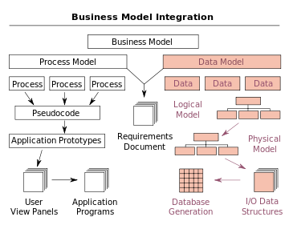
A Data Model:
  is a collection of concepts for describing data.
  often includes set of operations for retrievals & updates
  purpose is to provide a level of abstraction (i.e. hide details)
Notes:
5

Slide 16
Data Models
A data model
  is a collection of concepts for describing data.
  often includes set of operations for retrievals & updates
  purpose is to provide a level of abstraction (i.e. hide details)
A schema
  is a description of a particular collection of data, using the given data model.
The relational model of data is the most widely used model today.
  Relation is basically a Table with rows and columns.
  Every relation has a Schema.
    A Schema describes the columns, or fields.
Notes:
5

Slide 17
Example: University Database
Conceptual schema:
  Students(sid: string, name: string, login: string,
  age: integer, gpa:real)
  Courses(cid: string, cname:string, credits:integer)
  Enrolled(sid:string, cid:string, grade:string)
Physical schema:
  Relations(synonym for tables) stored as unordered files.
  Index on first column of Students (i.e. sid, student id)
External Schema (View):
  Course_info(cid:string,enrollment:integer)
Notes:
7

Slide 18
Instance of Students Relation/Table
  Students( sid: string, name: string, login: string, age: integer, gpa: real )
  sid name login age gpa
  53666 Jones jones@cs 18 3.4
  53688 Smith smith@ee 18 3.2
  53650 Smith smith@math 19 3.8

Slide 19
Data Independence
Applications are insulated from how data is structured and stored.
Logical data independence: Protection from changes in logical structure of data.
Physical data independence: Protection from changes in physical structure of data.
One of the most important benefits of using a DBMS!

Slide 20
Structure of a DBMS
These layers
must consider
concurrency
control and
recovery
A typical DBMS has a layered architecture.
This is one of several possible architectures; each system has its own variations.
Query Optimization
and Execution
Relational Operators
Files and Access Methods
Buffer Management
Disk Space Management
DB
Notes:
22

Slide 21
What does the term “Data” include?
A collection of tools for describing
  Data
  Data relationships
  Data semantics
  Data constraints
Relational model
Entity-Relationship data model (mainly for database design)
Object-based data models (Object-Oriented and Object-relational)
Semistructured data model (XML)
Other older models:
  Network model
  Hierarchical model

Slide 22
Outline of Today
ER Diagram: Entity Relationship Diagram
What’s an Attribute?
  Multi-valued attribute, Derived Attribute
Cardinality concept
  One-to-One, Many-to_Many, One-to-Many, Many-to-Many
What’s a Key
  Superkey, Candidate key, Primary key, Discriminator (Partial key)

Slide 23
Database Design
The process of designing the general structure of the database:
Logical Design – Deciding on the database schema. Database design requires that we find a “good” collection of relation schemas.
  Business decision – What attributes should we record in the database?
  Computer Science decision – What relation schemas should we have and how should the attributes be distributed among the various relation schemas?
Physical Design – Deciding on the physical layout of the database (what are your “tables”)

Slide 24
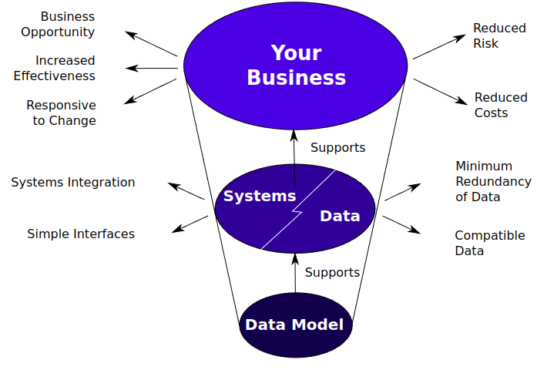

Slide 25
Database Modeling
and
Implementation Process
Ideas
ER Design
Relational Schema
Relational Database
Implementation

Slide 26

The Entity-Relationship Model
(aka ER-Model)
Models an enterprise as a collection of entities and relationships
  Entity: a “thing” or “object” in the enterprise that is distinguishable from other objects
    Described by a set of attributes
  Relationship: an association among several entities
Represented diagrammatically by an entity-relationship diagram:

Slide 27
Summary:
Why Split Information Across Relations?
Storing all information as a single relation such as
bank(account_number, balance,customer_name, ...)
  repetition of information
    e.g.,if two customers own an account (What gets repeated?)
  the need for null values
    e.g., to represent a customer without an account
Normalization theory deals with how to design relational schemas

Slide 28

Example Bank Schema

Slide 29
Outline of Today
ER Diagram: Entity Relationship Diagram
What’s an Attribute?
  Multi-valued attribute, Derived Attribute
Cardinality concept
  One-to-One, Many-to_Many, One-to-Many, Many-to-Many
What’s a Key
  Superkey, Candidate key, Primary key, Discriminator (Partial key)

Slide 30
Database Design
The process of designing the general structure of the database:
Logical Design – Deciding on the database schema. Database design requires that we find a “good” collection of relation schemas.
  Business decision – What attributes should we record in the database?
  Computer Science decision – What relation schemas should we have and how should the attributes be distributed among the various relation schemas?
Physical Design – Deciding on the physical layout of the database (what are your “tables”)

Slide 32
Database Modeling
and
Implementation Process
Ideas
ER Design
Relational Schema
Relational Database
Implementation

Slide 33
The Entity-Relationship Model
(aka ER-Model)
Models an enterprise as a collection of entities and relationships
  Entity: a “thing” or “object” in the enterprise that is distinguishable from other objects
    Described by a set of attributes
  Relationship: an association among several entities
Represented diagrammatically by an entity-relationship diagram:

Slide 34
Summary:
Why Split Information Across Relations?
Storing all information as a single relation such as
bank(account_number, balance,customer_name, ...)
  repetition of information
    e.g.,if two customers own an account (What gets repeated?)
  the need for null values
    e.g., to represent a customer without an account
Normalization theory deals with how to design relational schemas

Slide 35
Example Bank Schema

Slide 36
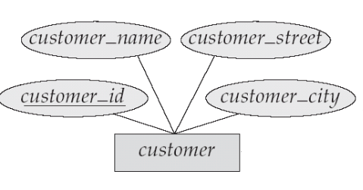
Attributes
An entity is represented by a set of attributes, that is descriptive properties possessed by all members of an entity set.
Domain – the set of permitted values for each attribute
Attribute types:
  Simple and composite attributes.
  Single-valued and multi-valued attributes
    Example: multivalued attribute: phone_numbers
  Derived attributes
    Can be computed from other attributes
    Example: age, given date_of_birth
customer = (customer_id, customer_name, customer_street, customer_city )
loan = (loan_number, amount )

Slide 37
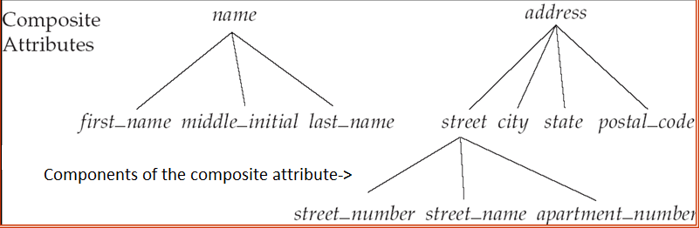
Composite Attributes

Slide 38
Criteria for selecting identifiers
Some entities have more than one candidate identifier
  Choose identifier that will not change in value over the life of each instance of the entity type
  Choose identifier that is guaranteed to have valid values and will not be null (or unknown).
  If composite, make sure all parts will have valid values

Slide 39
Criteria for selecting identifiers
Avoid the use of intelligent identifiers whose structure indicates classifications, locations or people that might change in time.
  e.g. the first two digits of an identifier may indicate a warehouse location, but such codes are often changed as conditions change, which renders them invalid.
Consider substituting new, simple identifiers for long, composite ones
  e.g. an attribute called Game_Number could be used for the entity type GAME instead of Home_Team and Away_Team

Slide 40
Mapping Cardinality Constraints
Express the number of entities to which another entity can be associated via a relationship set.
Most useful in describing binary relationship sets.
For each binary relationship, you need to set the mapping cardinality.
Ask yourself (and your customer): What’s the type of the relationship?
  One to One?
  One to Many?
  Many to One?
  Many to Many?

Slide 41
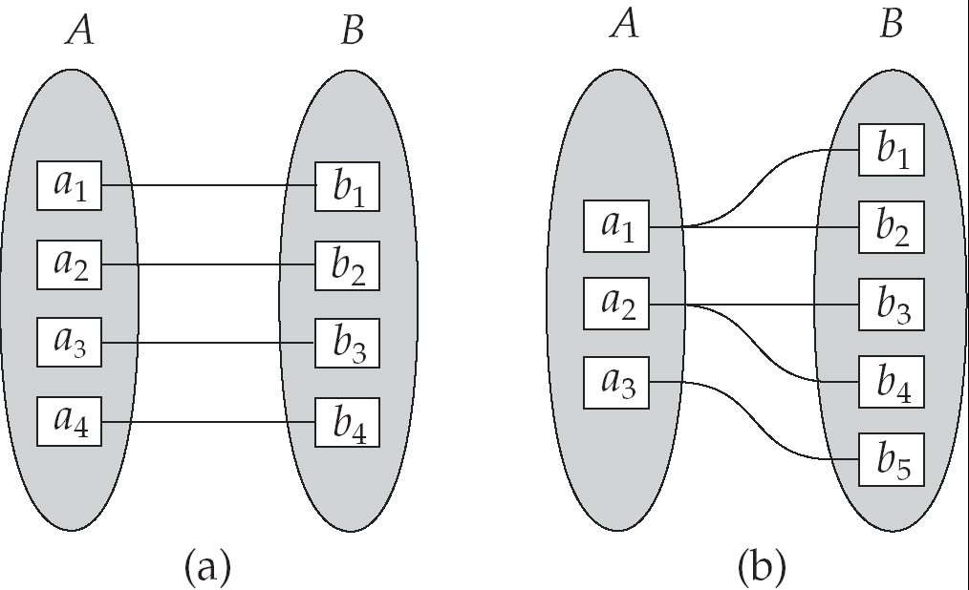
Mapping Cardinalities
One to one
One to many
Note: Some elements in A and B may not be mapped to any
elements in the other set

Slide 42
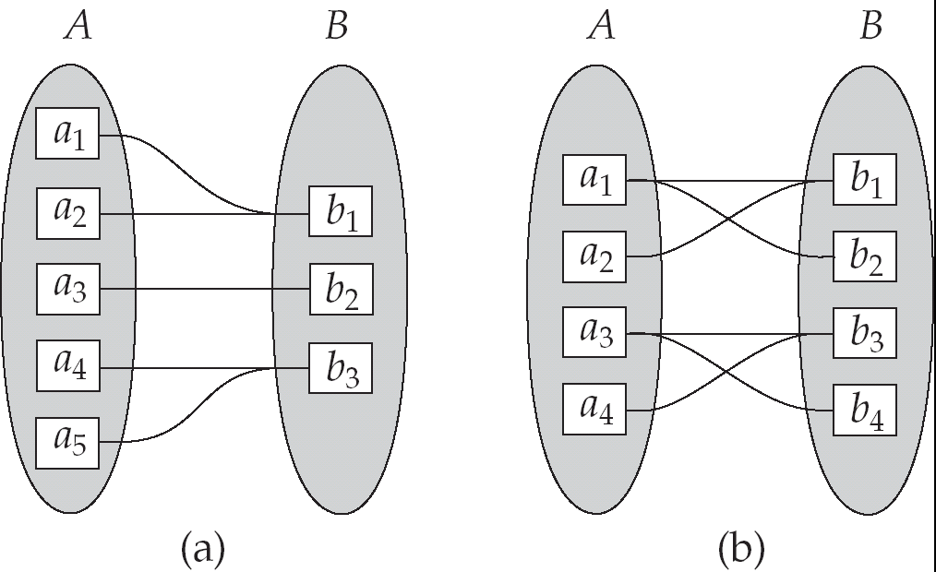
Mapping Cardinalities
Many to one
Many to many
Note: Some elements in A and B may not be mapped to any
elements in the other set

Slide 43
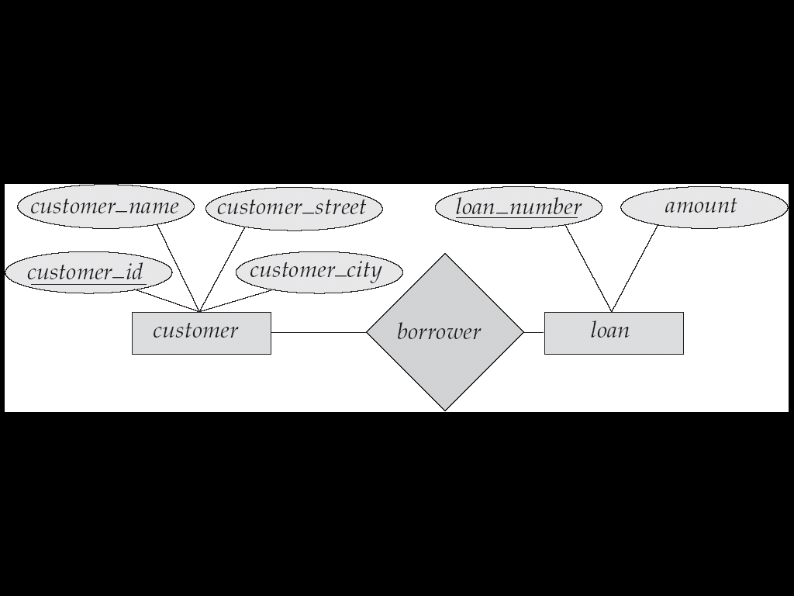
E-R Diagrams
Rectangles represent entity sets.
Diamonds represent relationship sets.
Lines link attributes to entity sets and entity sets to relationship sets.
Ellipses represent attributes
  Double ellipses represent multivalued attributes.
  Dashed ellipses denote derived attributes.
Underline indicates primary key attributes

Slide 44
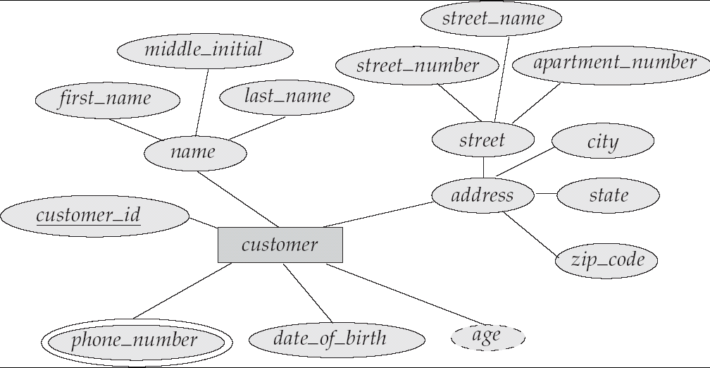
E-R Diagram with
Composite, Multivalued, and Derived Attributes

Slide 45
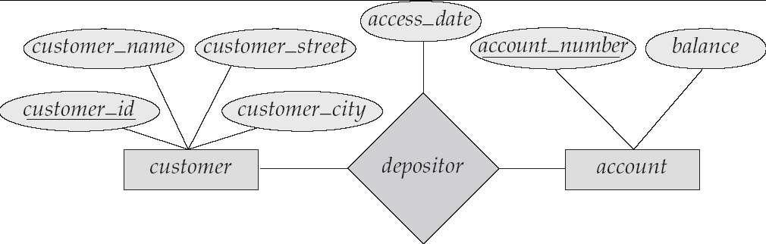
Relationship Sets with Attributes

Slide 46
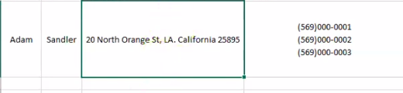
Let’s normalize this single row table

Slide 47
